Slide 1



DBMS Assignment 1
Design and Implementation of a database management system for Research Project, Publication and Grant Management System
Presentation 3

Slide 2
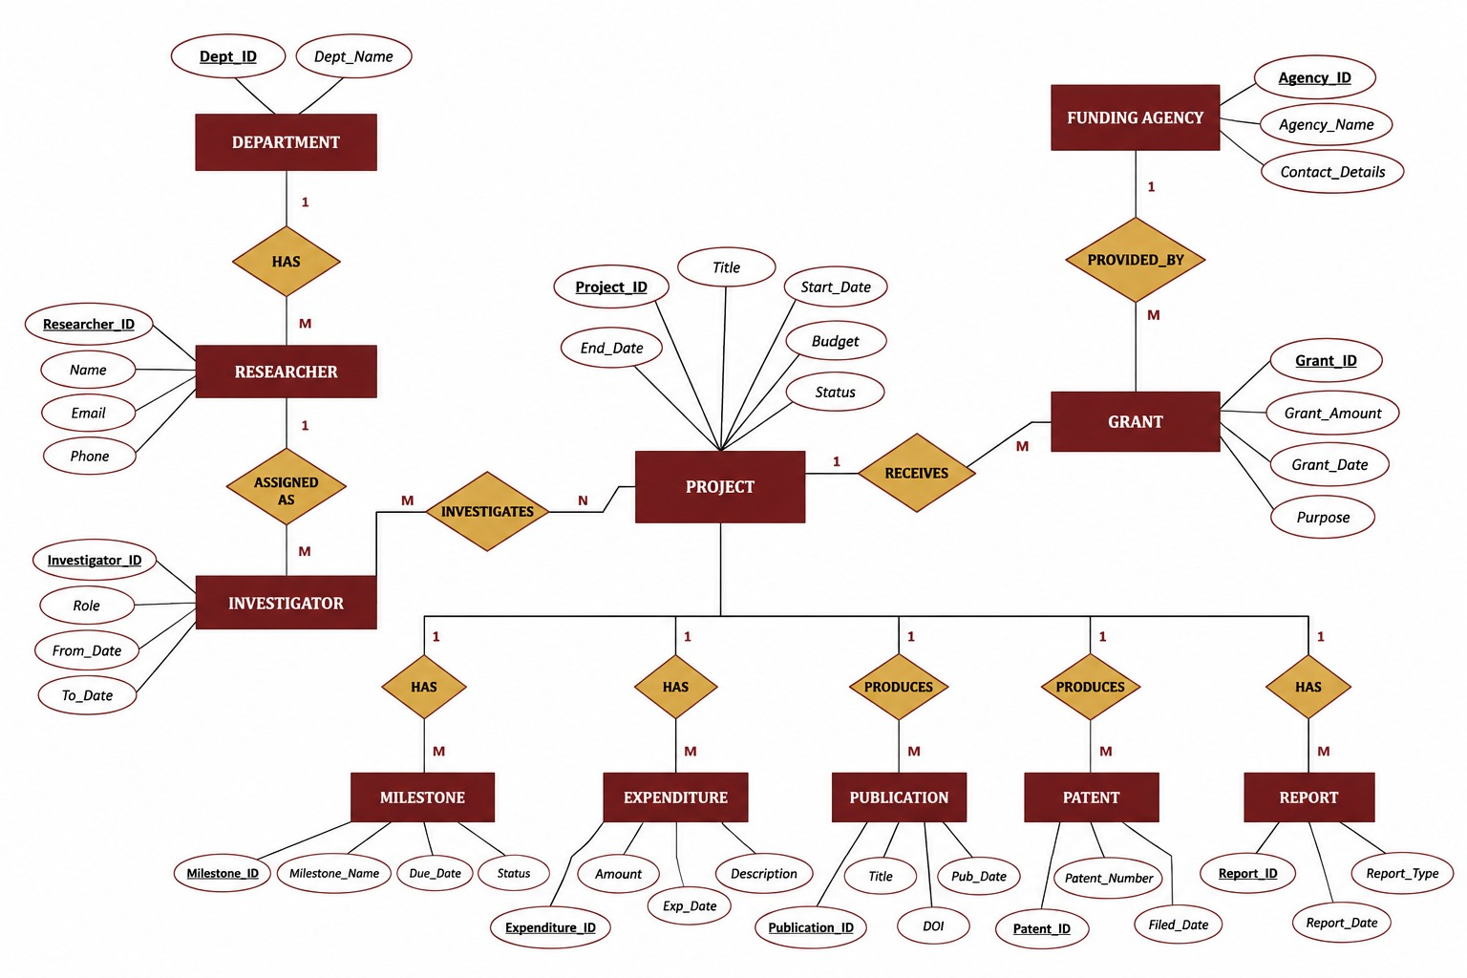
Conceptual ER Diagram

Slide 3
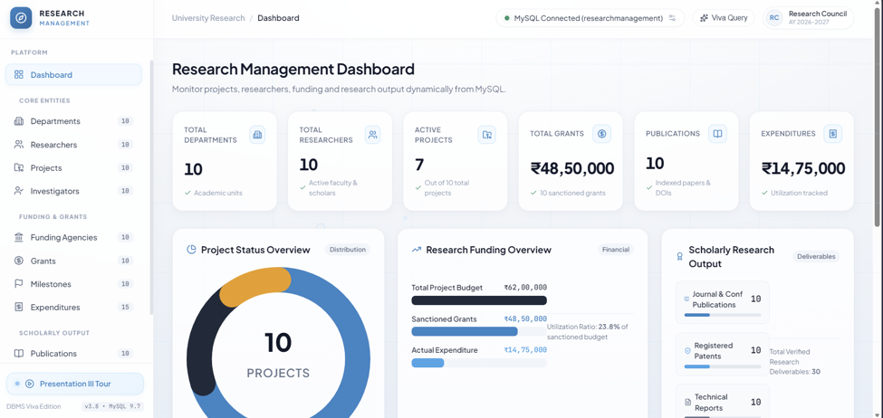
UI Dashboard

Slide 4
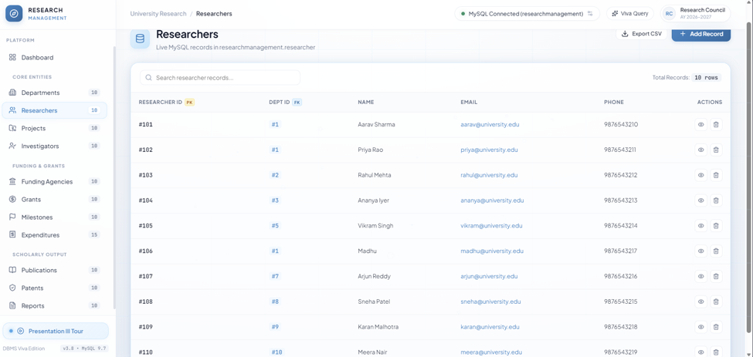
Screenshot of Researchers

Slide 5
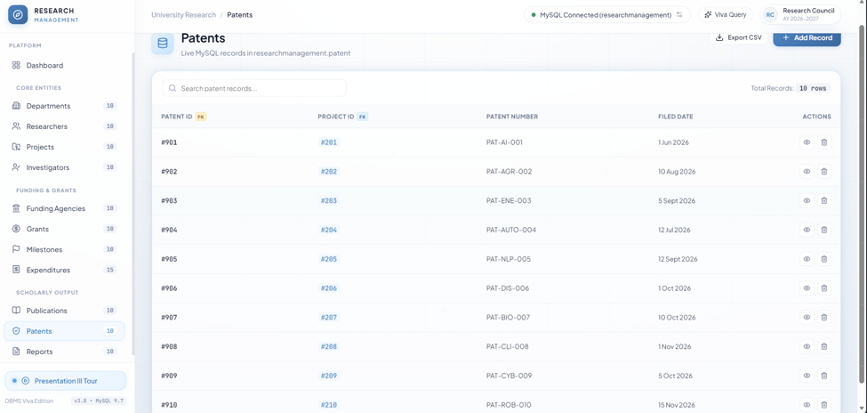
Screenshot of Patents

Slide 6
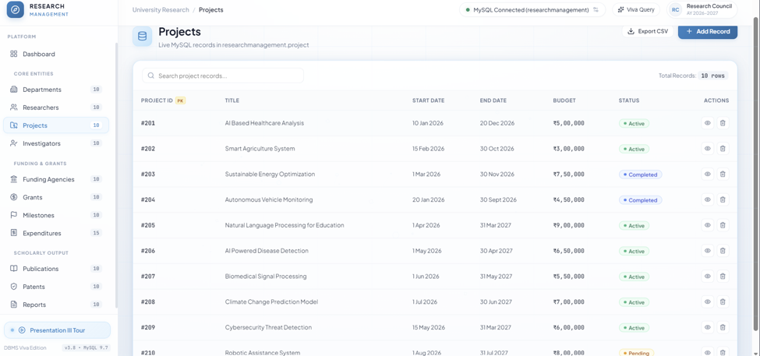
Screenshot of Projects

Slide 7
Thank You
(review 3)

